Slide 1
SPEECH EMOTION RECOGNITION USING MLP
Guide: submitted by:
FOUSIA SHAMSUDEEN ANJALI R(34) HARILEKSHMI U j(38)

Slide 2


OVERVIEW
INTRODUCTION
REQUIREMENTS
ARCHITECTURE
CLASSIFIERS
RESULT
REFERENCE

Slide 3
INTRODUCTION
Speech Emotion Recognition, is the act of attempting to recognize human emotion and affective states from speech.
We define a SER system as a collection of methodologies that process and classify speech signals to detect emotions embedded in them. This model can perform two operations.
Such a system can find use in a wide variety of application areas like interactive voice base-assistant or caller-agent conversation analysis.
The significant parts of SER are the signal processing unit in which relevant features are extracted from speech signal and classified in order to bring out the emotion to the particular class

Slide 4
REQUIREMENTS
Prerequesties: librosa, numpy, pandas, soundfile, wave, tqdm, pyaudio
Dataset: RAVDESS, TESS, EMO-DB

Slide 5
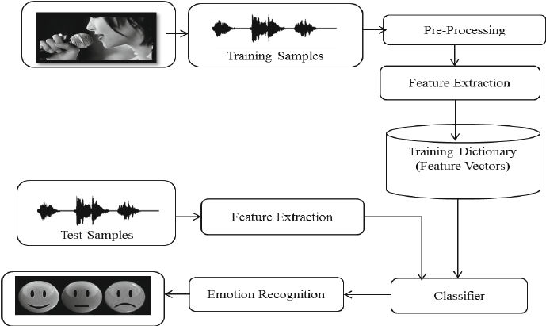
ARCHITECTURE

Slide 6
FEATURE EXTRACTION
Feature extraction is the main part of SER.
It is accomplished by changing the speech wave form to a form of parametric representation at a relatively lesser data rate.
We have used the most used features that are available in librosa library including:
MFCC
Chromogram
MEL Spectrogram Frequency( MEL)

Slide 7
MODELS USED
MLP Classifier
Multilayer perceptron(MLP) is a class of feedforward artificial neural network.
MLP utilizes a supervised learning technique called backpropogation for training.
Its multiple layers and non-linear activation distinguish MLP from a linear perceptron.

Slide 8
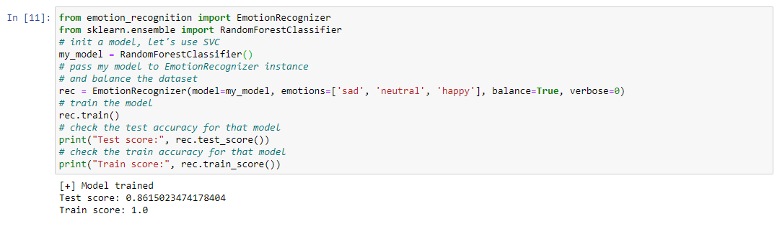

Slide 9
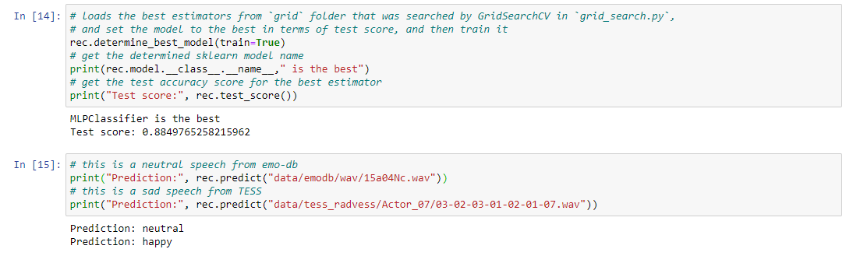

Slide 10
CONTINUE…
2. Random Forest Classifier
Random Forest Classifier is a classification algorithm consisting of many decision trees
It is a flexible, easy to use machine learning algorithm.
It works by selecting random samples from a given dataset and then construct a decision tree for every sample.

Slide 11
CONTINUE….
3. SVC
The objective of SVC is to fit to the data you provide, returning a best fit hyperplane that divides, or categorizes your data.
After getting the hyperplane, you can then feed some features to your classifier to see what the predicted class is.

Slide 12
CONTINUES…
4. Gradient Boosting Classifier
Gradient Boosting Classifiers are a group of machine learning algorithms that combine many weak learning models together to create a strong predictive model.
Decision trees are usually used when doing gradient boosting.

Slide 13
CONTINUES…
5. Kneighbours classifier
Kneighbours classifier implements classification based on voting by nearest K-neighbours of target point t.
By default Kneighbours classifier looks for the five nearest neighbours.

Slide 14
CONTINUES….
6. Bagging Classifier
A Bagging classifier is an ensemble meta estimator that fits base classifiers each on random subsets of the original datasets.
Then aggregate their individual predictions to form a final prediction.

Slide 15
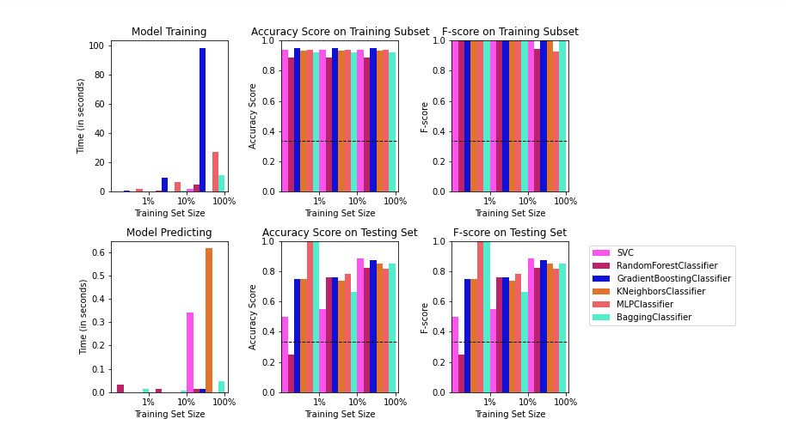
COMPARISON CHART

Slide 16
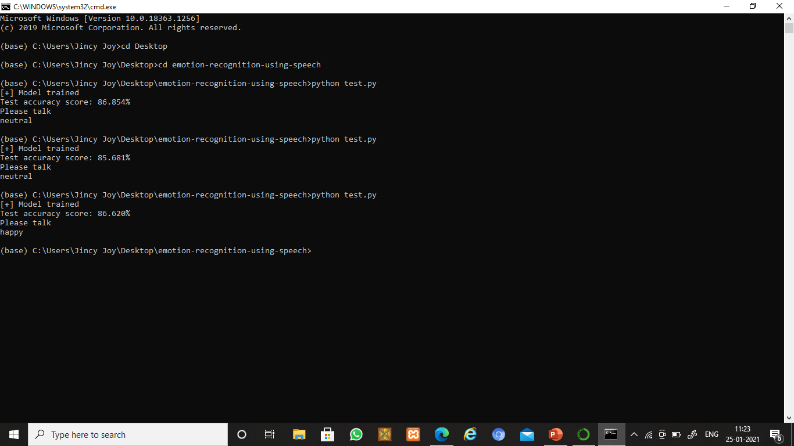
RESULT

Slide 17
REFERENCE
SPEECH EMOTION RECOGNITION USING DEEP LEARNING TECHNIQUES (IEEE 2019)

Slide 18
THANK YOU

